Slide 1
Morning !!!
Get your name tag
Check-in

Slide 2
iClicker Question
How to handle missing data?
Just ignore it (assuming missing at random)
Try to impute missing values (i.e., substitute values for missing items)
Contact respondents or try to find raw data
All of the above

Slide 3
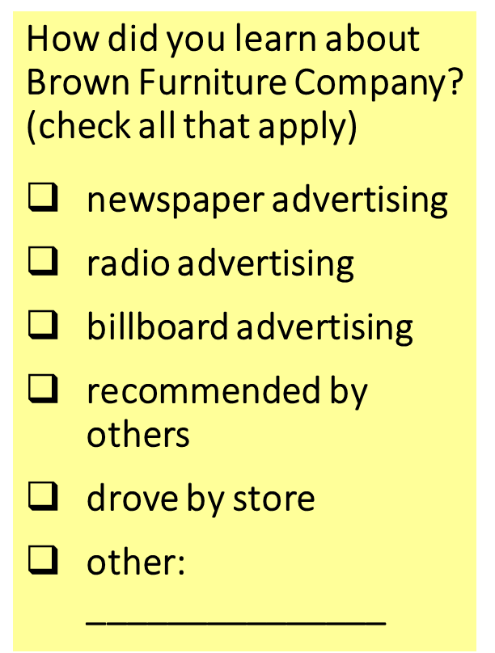
iClicker Question
How can you code this closed-ended item into your data frame?
Assign a column (in the data frame) for each box, where 1 represents the box is checked
Assign a column (in the data frame) for the item, where labels are from 1-6 corresponding to 6 boxes.

Slide 4

iClicker Question
How do you code this item:
In your own words, give us 2 or 3 reasons why you prefer to leave the state after graduation
You can’t code this question. It’s an open-ended item that is used for exploratory research only
You develop categories for responses and get multiple coders to sort responses into categories to get consensus for the true categorization.

Slide 5
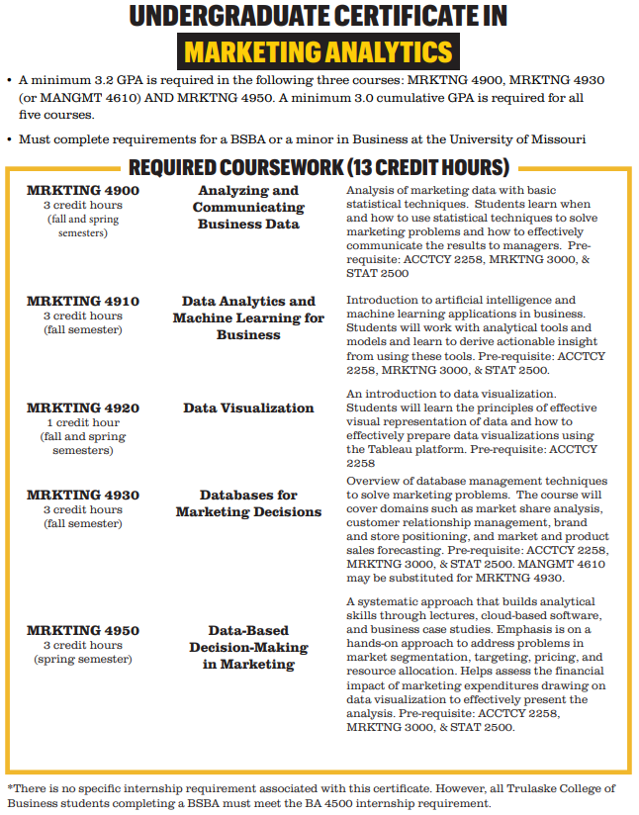
Marketing Analytics Certificate
Notes:
This certificate program is ideal for students who enjoy working with numbers and love learning new software skills for business. Students who finish the 13-credit hour curriculum earn the certificate upon completion of their bachelor’s degree, providing employers with strong evidence that they have cutting-edge skills to excel in an analytics career.
So here you can see all the courses that you have to take, and its requirements. For more information, you can google search for this certificate online or go to our class Canvas page, I also posted a link of it under the first module.
(Show students how to access)

Slide 6
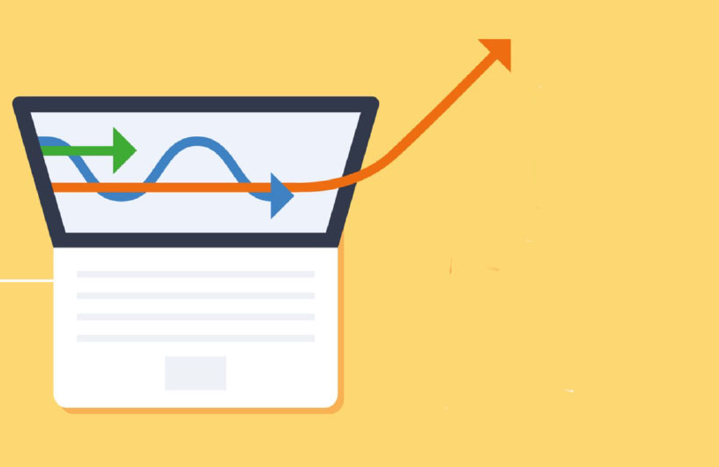
Marketing Analytics Certificate
Use data to provide insights to marketing decision makers
High demand for graduates with marketing analytics skills
Spring semester courses:
Mrktng 4900, Analyzing Business Data
Mrktng 4920, Data Visualization (Tableau)
Mrktng 4950, Data-Based Decision Making
Questions? contact marketinganalytics@missouri.edu
Notes:
So for the next semester, there will be three courses for you already.
Idk about other courses, but for the second one. It uses Tableau, which is increasingly more famous and popular in the industry. Hence, I think it could be a valuable tool for you.
For more information, you can contact …

Slide 7




Descriptive Statistics
Notes:
Chapter 12 revisit
So today we will cover descriptive statistics and revisit chapter 12 a little bit.

Slide 8
Basic Descriptive Analysis
Variation = Difference between measurements
Variation
Mean
Median
Mode
Range
Notes:
When we talk about descriptive statistics, usually we mean we want to learn some basic information about a variable.
Such as its mean or variation.

Slide 9
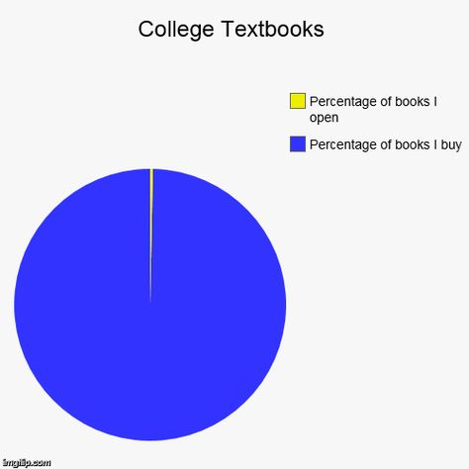
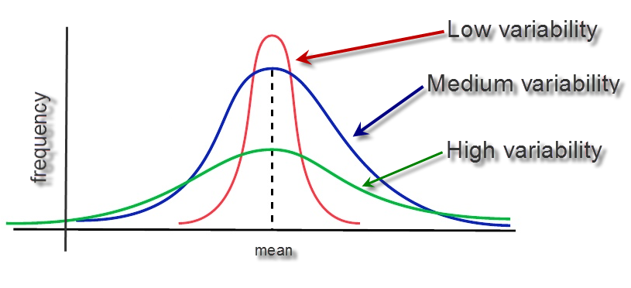
Commonly Used Descriptive Analysis
Raw frequency or percent: Measures of central tendency (typical response): Used to report a single piece of information that describes the most typical response to a question
Measure of variability (uncertainty): used to reveal the typical difference between the values in a set of values
Notes:
One of the most two frequently used descriptive statistics are raw frequency or percent. It measures the central tendency. Like in the picture, you can see that the percentage of books you buy dominate the percentage of books that you open
The second one is variability associated with a variable; it is used to reveal the typical difference between the values in a set of values.
As in the picture, you recall your stat class where you learn about the distribution of a random variable.
The more information you have, the less uncertainty you have about the variable, hence, lower variability.

Slide 10
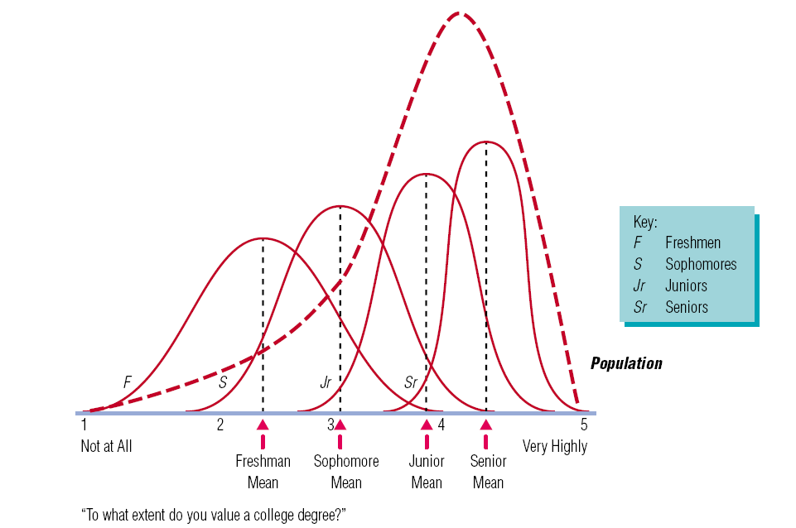
Probability Sampling Methods
Central tendency = the center of the bell shape
Variance is the spread
Notes:
If you can recall sampling methods that we’ve learned so far.
We cover both probability sampling and non-probability sampling
Only probability sampling allows us to calculate the measurement error. And visualize the underlying distribution of a variable.
For example, assuming that we know the overall population parameter of the extent o which you value a college degree is left skewed. You would want to have a random sample of the population
But say that you only collect freshman’s opinion, then your sample is not reflective of the population. Hence, that’s why you always want to get the most representative sample as possible.
Is there any questions?

Slide 11
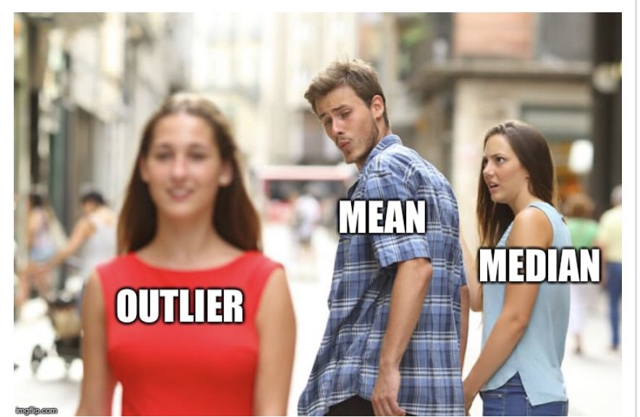
Measures of Central Tendency
Average (Arithmetic mean): the average value characterizing a set of numbers
Mode: The value in a string of numbers that occurs most often
Median: the value whose occurrence lies in the middle of a set of order values
Geometric mean: the central number in a geometric progression (n-th root of a product of n numbers) such as interest rate, human population.
Notes:
These are measure of central tendency, which we covered already but I just want to remind you the definition.
I just want to caution you the difference between geometric and arithmetic means again since we have quite a few got it incorrectly in our previous iclicker question.
Geometric mean is the n-th root of a product of n numbers, while arithmetic mean is the sum of n numbers divided n.

Slide 12
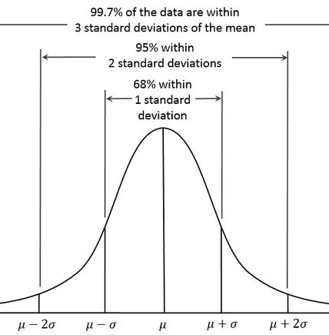
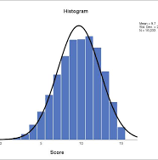
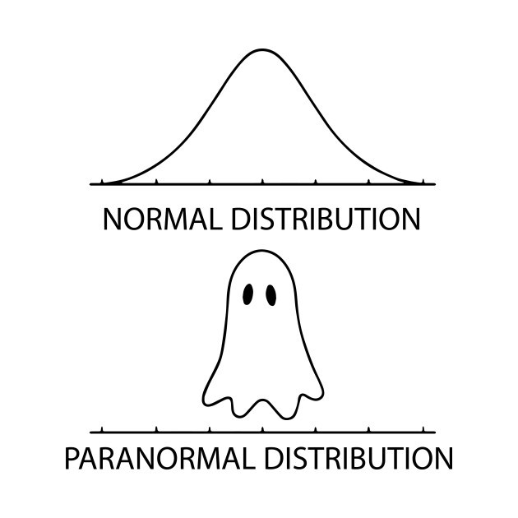
Measures of Variability
Frequency distribution reveals the number (percent) of occurrences of each number or set of numbers
Range identifies the maximum and minimum values in a set of numbers
Standard deviation indicates the dispersion of the values
Notes:
Measures of variability can be variance or standard deviation.
Standard deviation indicates the dispersion of the values
If you recall from your stat course, if you have a normal variable such as height, 1 standardization contain 68% of observations, meaning that 68% of your sample should be plus or minus from your mean.
Another visualization of a distribution of a variable is frequency distribution or histogram. Unlike variable distribution can only be used for continuous variables measured by ratio, histogram can also be used for continuous variables measured by interval such as Likert scale or salary in bucket.
For example, in the histogram, you can see that the number of people is put into a bucket. And we stack them side by side.

Slide 13
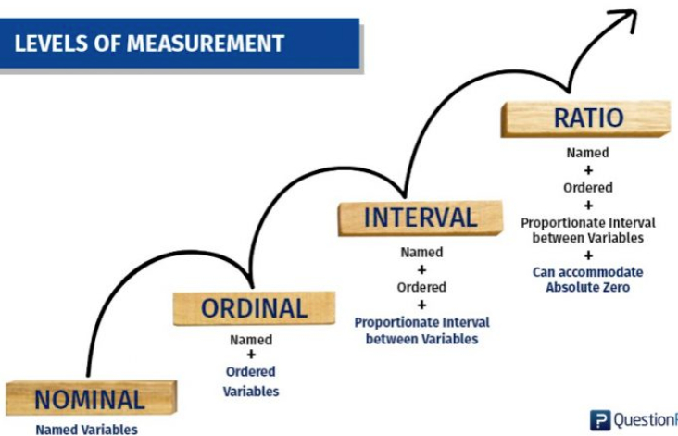
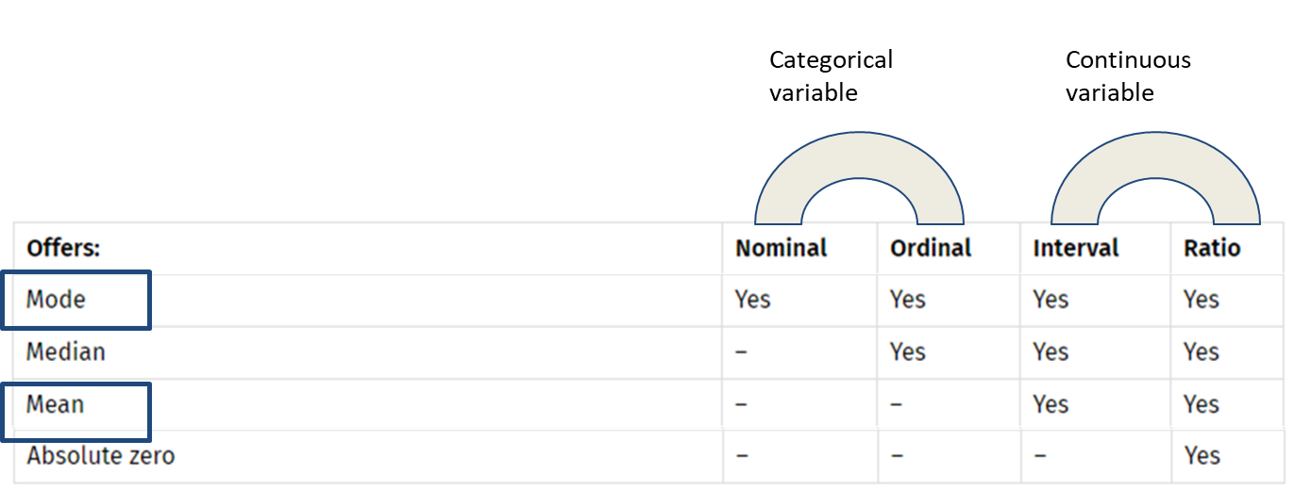
Statistical Procedure
Mode: categorical and continuous
Mean: only continuous. why?
Notes:
As you can see, to get to the next level of measurement, we have to impose more conditions such as from nominal to ordinal, we have to add the order of variables.
From ordinal to interval, we have to add the restriction that proportion between variables are equal. (a jump from 1 to 2 equals a jump form 2 to 3)
And from interval to ratio, we have to add the condition of absolute zero or real zero.
And higher levels of measurement have all the statistical property of lower levels of measurements as represented in the table.
So can somebody tell me why mode can be used for both catogeial continuous variables, while mean only applies to continuous variables.
Or give me examples
Rights reserved: www.questionpro.com

Slide 14
iClicker Question
Which measure of central tendency (mode or mean) should you use?
Gender of respondent (Male or Female)
Hint: Can you do average gender? How do you calculate average?
Mode
Mean

Slide 15
iClicker Question
Which measure of central tendency (mode or mean) should you use?
Customer Satisfaction (How satisfied are you with the store’s customer service? – use 5-point scale where 1 means not satisfied and 5 means very satisfied).
Mode
Mean

Slide 16

Lab Session
Excel
R
Notes:
Go over descriptive word doc first
Then R script
Variables are ”elements of a construct that can be measured or quantified”
Construct is “an abstract idea or concept composed of a set of attitudes or behaviors that are thought be related.”
measurement is amount of information within a variable.
Levels of measurement consists of nominal, ordinal, interval, and ratio
Type of research question:
Exploratory
Descriptive
Causal

Slide 17
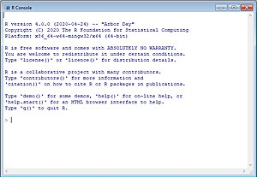
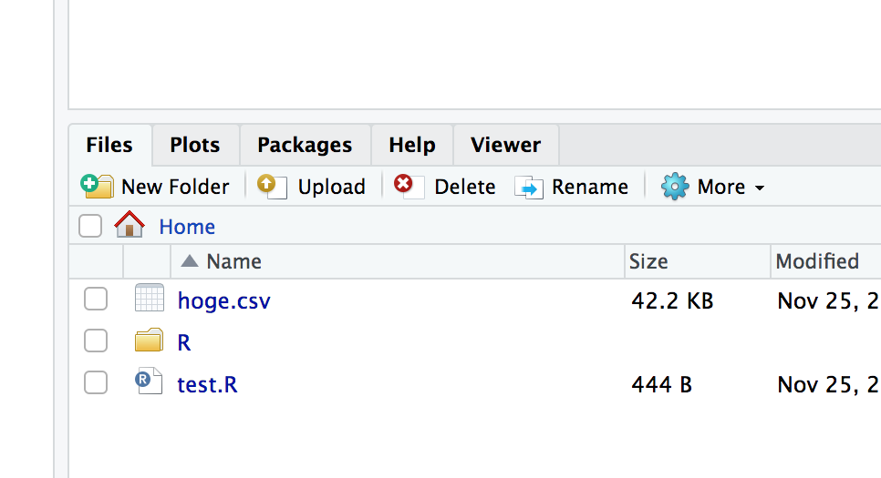
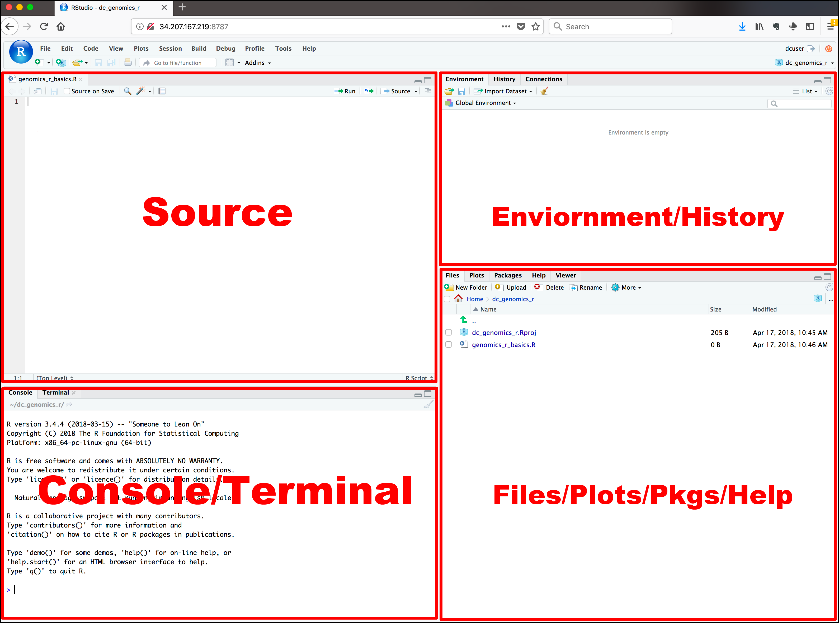
A little bit about R
R is the underlying language
RStudio is the IDE for R
RStudio Cloud is a cloud version of RStudio
This Photo by Unknown Author is licensed under CC BY-SA
This Photo by Unknown Author is licensed under CC BY-SA
This Photo by Unknown Author is licensed under CC BY-SA
This Photo by Unknown Author is licensed under CC BY
Notes:
IDE = Integrated Development Environment

Slide 18


5-minute Snippet
How Rumor Spread
The more seeding you have, the faster rate of transmission
Notes:
http://www.netlogoweb.org/launch#http://www.netlogoweb.org/assets/modelslib/Sample%20Models/Social%20Science/Rumor%20Mill.nlogo
This program models the spread of a rumor. The rumor spreads when a person who knows the rumor tells one of their neighbors. In other words, spatial proximity is a determining factor as to how soon (and perhaps how often) a given individual will hear the rumor.
The neighbors can be defined as either the four adjacent people or the eight adjacent people. At each time step, every person who knows the rumor randomly chooses a neighbor to tell the rumor to. The simulation keeps track of who knows the rumor, how many people know the rumor, and how many "repeated tellings" of the rumor occur.
EIGHT-MODE? is a switch that determines whether at each time step the rumor spreads to one of four randomly chosen neighbors, or one of eight such neighbors.
Also check the network analysis

